Slide 1

Implement Music Retrieval System
by Shazam’s Fingerprinting Algorithm
Presented by:
Kerui Hu, Yiming Sun, Yajun Wan

Slide 2
Concepts Overview
Project Introduction
Algorithm Explanation
Result Analyze (progress so far)
Future Work

Slide 3




Project Introduction
Why we need
music retrieval tools
Implementing & Testing algorithms
Bingo :)
Notes:
Part 1Imagining a scenario that you are attracted by the melody played around, however your phone can’t find the entire piece of the song without a given name, therefore, the need of query by vocal or humming is growing. Also, with the gradually growing size of music database, both computer system and music consumers need efficient music retrieval algorithm to scan through huge database.
Part 2: So, here comes the most significant concept of the process. How to extract the most appropriate information from the audio and the sample and then looking for the perfect matching with each other.Thanks to Shazam for introducing this algorithm by finding the key values in both original audios and samples by applying fingerprinting algorithm then find the fingerprints pairs and choose the time location, the frequency for both anchor point and point in target zones as parameters and pack the pairs into a reference database. Finally, if the fingerprints in sample audio’s reference database hold the maximum similarity as the fingerprints in original audio’s database, then bingo, we got it!

Slide 4
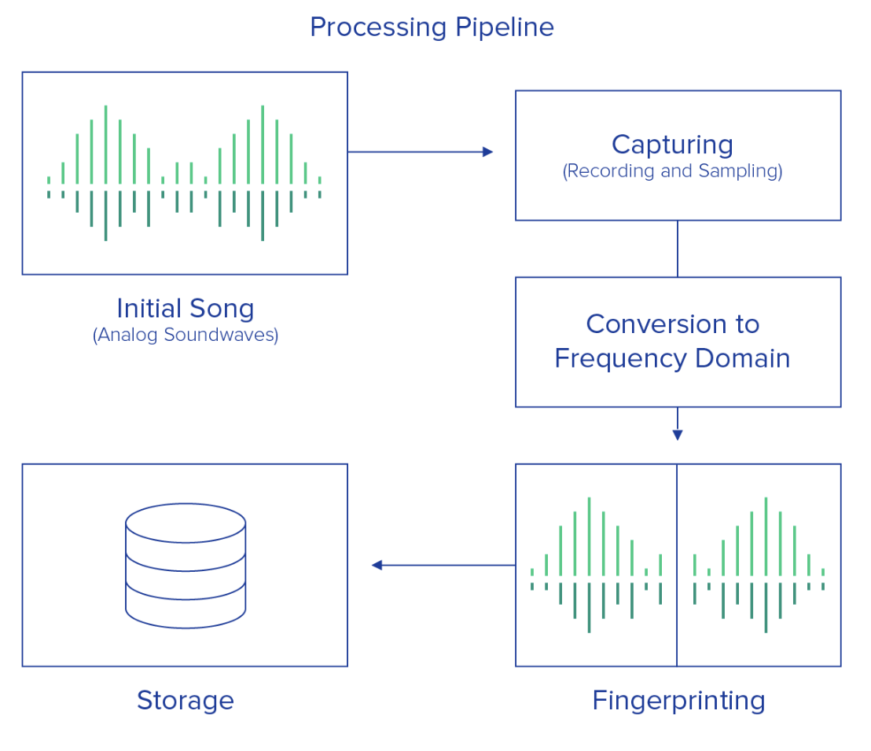
Algorithm Explanation
Figure 1. Processing Pipeline
Figure 1. Processing Pipeline [1]
Notes:
As we mentioned before, the basic process is shown as the figure here, in order to keep the information on time domain, we need to apply short time fourier transform by utilizing Hanning window, then we are able to process the audio frame by frame.

Slide 5
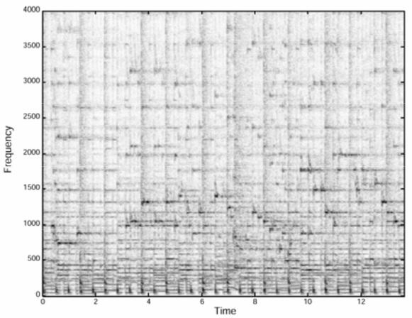
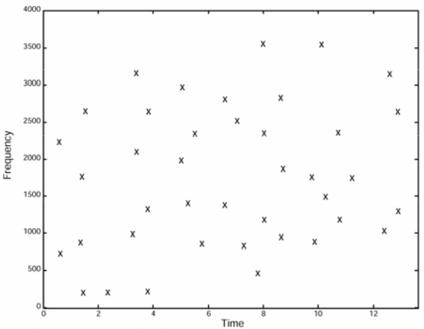
Algorithm Explanation: peak frequencies
Figure 2. Spectrogram [2]
Figure 3. Constellation Map [2]
Notes:
The left diagram shows the spectrogram after applying short time fourier transform of the audio, as you can see that there are dots with darker and more intensive shades, those are the peak energy of the spectrum which represents the frequencies with the highest amplitude， the reason to choose this group of points to generate the constellation map over there is that they are said to hold the most probability to survive the noise distortions.

Slide 6
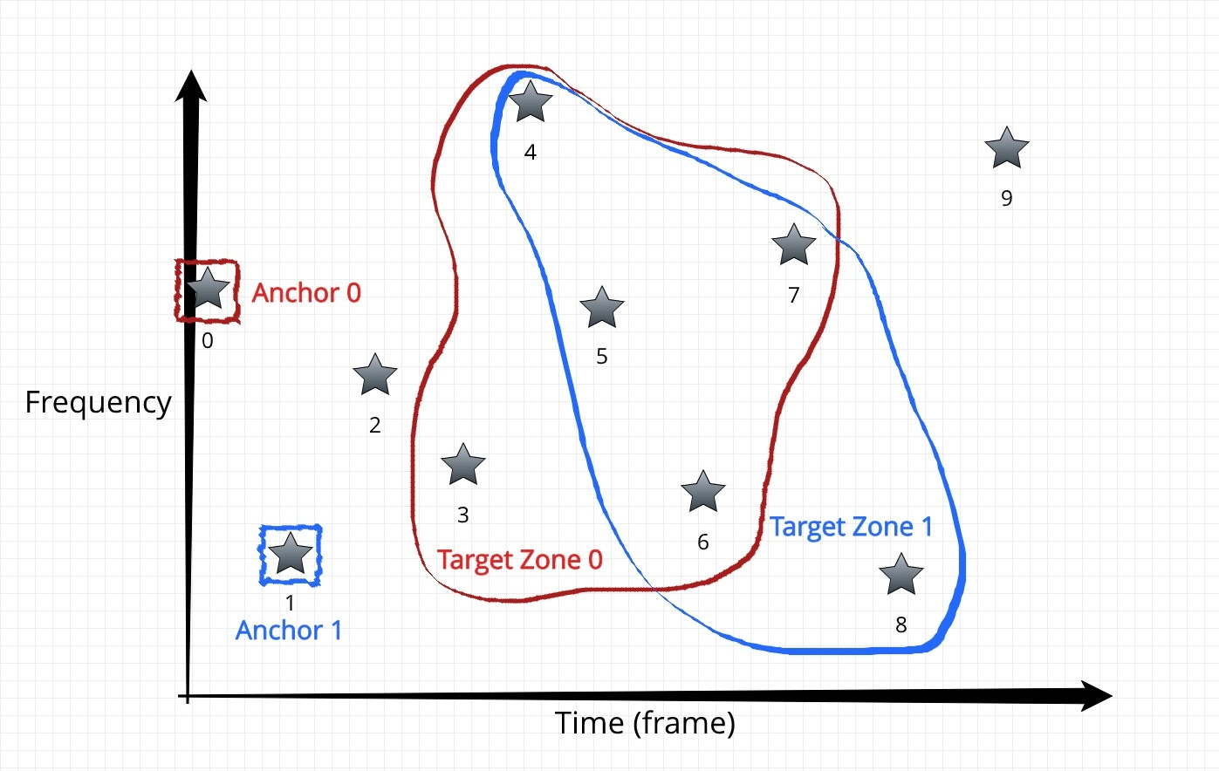
Algorithm Explanation: fingerprinting
e.g.:
Anchor distance = 3
Fan-out factor = 5
Fingerprint =
[(f0, f3, 3), (f0, f4, 4), …,
(f1, f4, 3), (f1, f5, 4), …,
…]

Slide 7
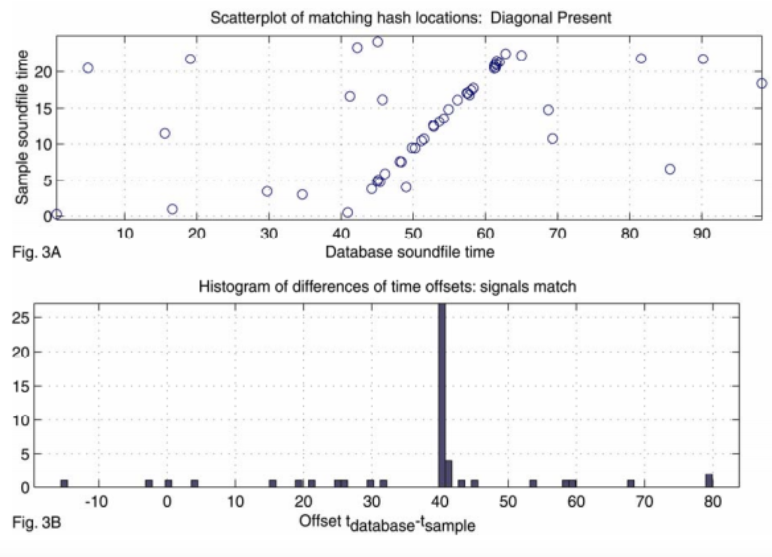
Algorithm Explanation
Algorithm Explanation: matching
Figure 4. Matching [2]

Slide 8
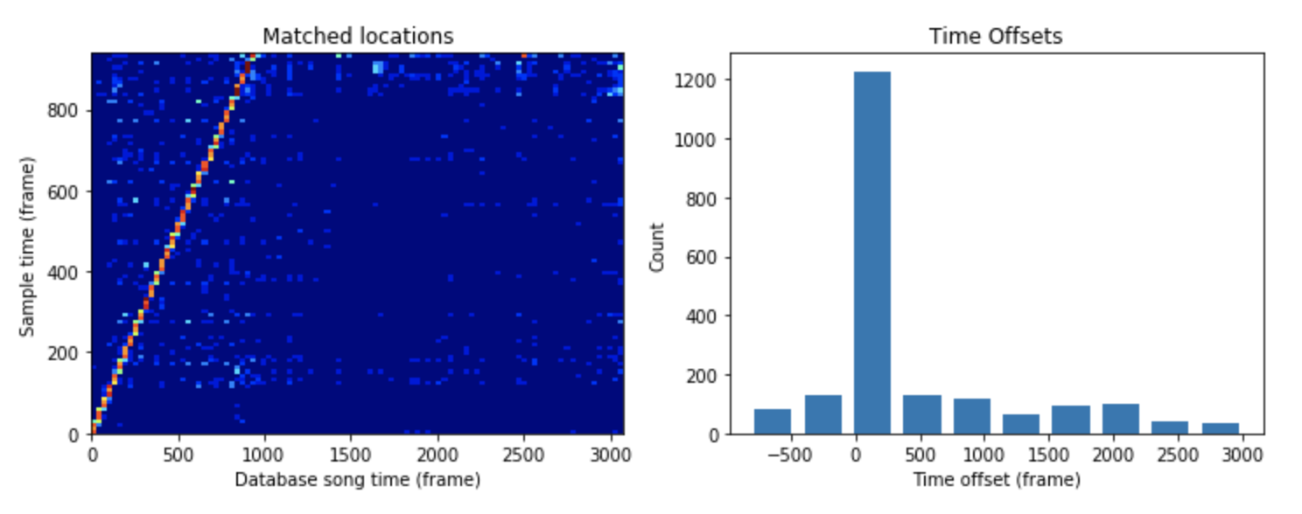
Result Analyze: 1 to 1 matching
Matching a 10-second clip to a 30-second song (rock.wav from GTZAN [3])
Notes:
For testing the algorithm, I firstly clipped a 10-second sample from a 30-second song, and match their fingerprints. as you see, there is clearly a straight line with a slope of 1 shown on the map, which indicates a match. Again, we can numerically indicate its existence by plotting a histogram of the time offsets of every matched fingerprints. In this case, the offsets are concentrated on the same value, and it has a count of about 12 hundreds. We regard this count a score of matching, which will be used to compare the matching against other songs.

Slide 9
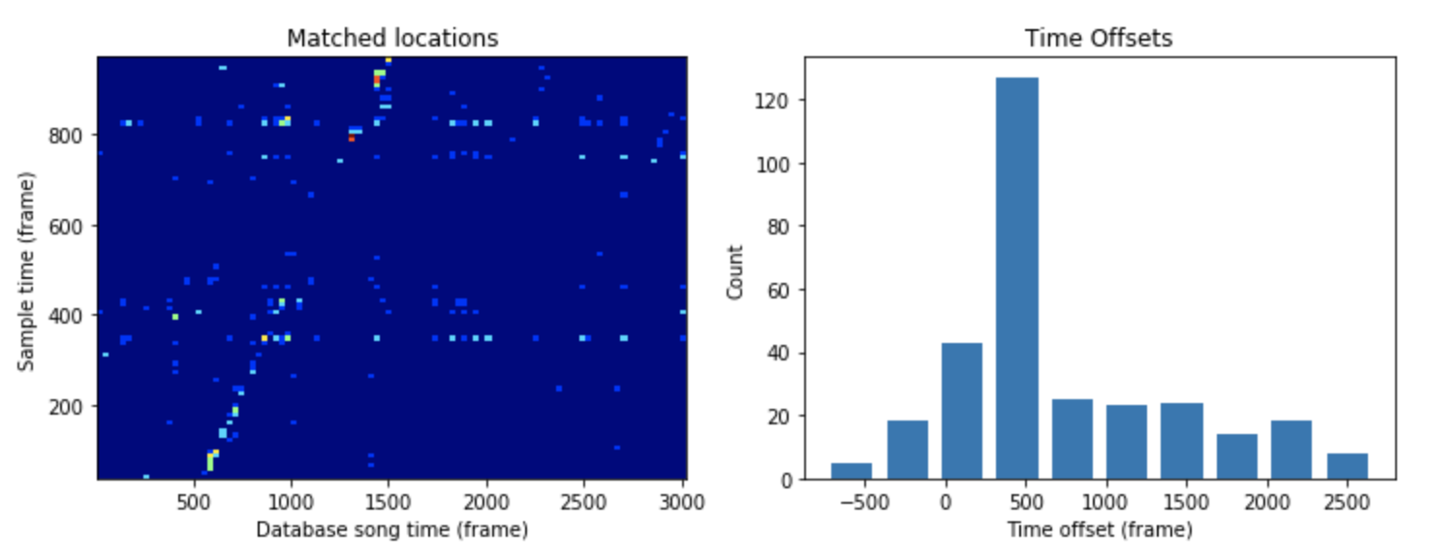
Result Analyze: 1 to 1 matching
Matching a 10-second recording to a 30-second song (rock.wav from GTZAN [3])
Notes:
Then, I created another 10-second sample by recording the song with the microphone on my laptop. At this time, the line still exists , but it is much more faded, and the score is only about a hundred and 20.

Slide 10
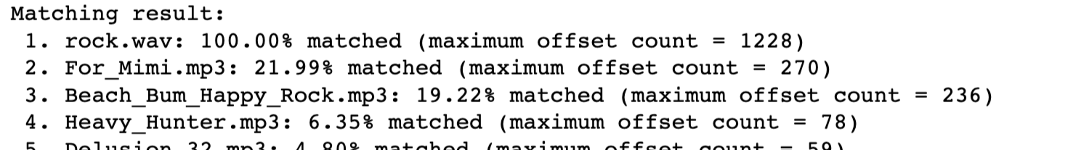
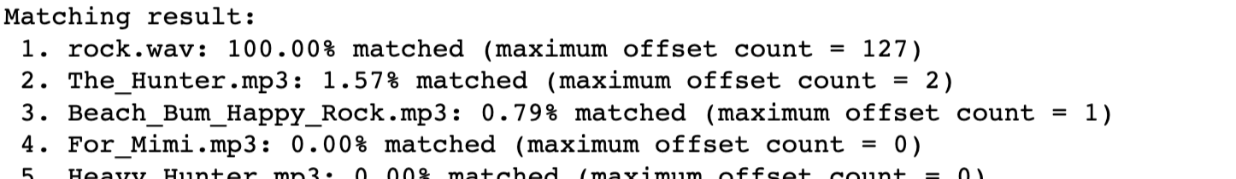
Result Analyze: 1 to 10 scoring
Query with the clip:
Other songs are retrieved from Youtube’s Audio Library (rock genre, 0:30 - 1:00) [4]
Query with the recording:
Notes:
Next, I fingerprinted 10 rock songs to create a mini dataset, and query with both my clip and recording. They both gave me the correct results. However, although the matching score for the recording is much less than which for the clip, the query with the recording has higher level of confidence, as the score of its top result dominate the others. By contrast, for the clip, the second and the third results have relatively high scores. Therefore, the algorithm is turned out to be noise-tolerable.

Slide 11
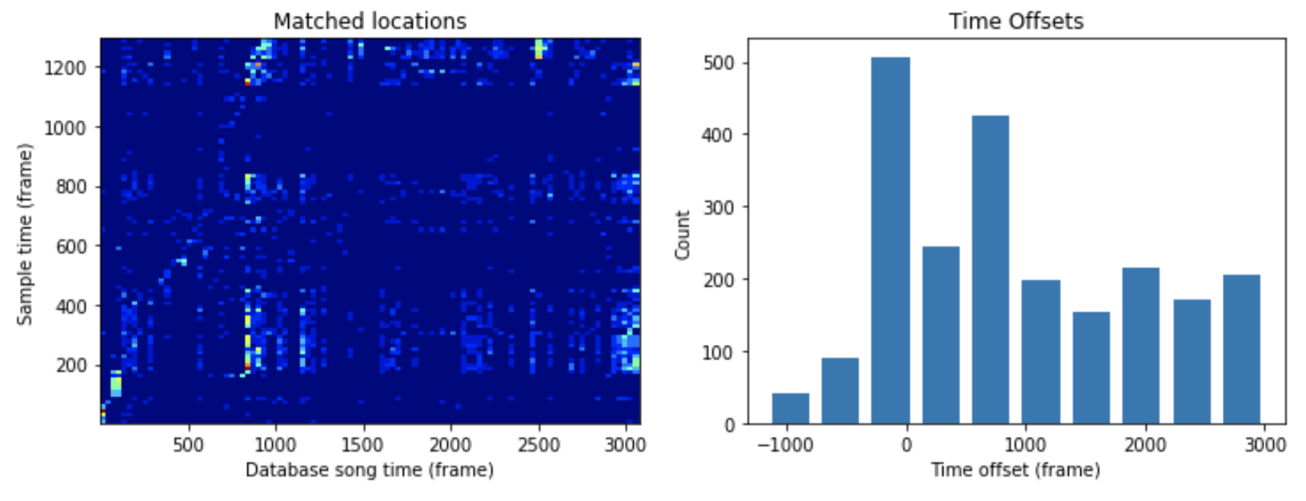
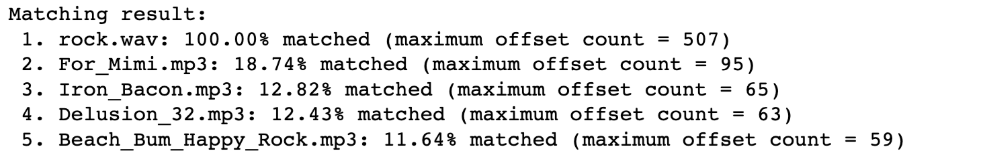
Result Analyze: time stretching
Matching and query results by the 10-second recording at 0.75 speed:
Notes:
Also, we found the algorithm can work with time stretched samples. If I slow down the recording sample and query with it, the result is still positive, even though the graphs are ugly. In addition, Shazam’s algorithm can not be used for query by humming, or query with a version of a song which is not in the database, because in that ways the sample has different frequencies.

Slide 12

Future Work
Improve time and space efficiency by Hashing
Adjustments and evaluation
Parameters and input quality:
fequency bin and frame size,
anchor distance and fan-out factor,
sample length and noise level,
etc.
Performance measures:
time and space usage,
confidence level,
etc.
Notes:
At this point, we have only implement the basics of Shazam’s algorithm, and it is super slow: it took roughly 20 seconds to fingerprint the mini database, and 20 seconds for querying a 10-second sample. Our priority now is trying to hash the fingerprints, which should significantly improve the time and space efficiency. Then, we will evaluate the effects of parameters like frame size, fan-out factor, length and noise level of the sample.

Slide 13
Thanks for Listening! Questions?
References:
[1] : Christophe, “How does Shazam work”. Aug. 5,2015. [online]. Available:http://coding-geek.com/how-shazam-works/ . [Accessed Dec.2, 2019]
[2] : Avery Li-Chun Wang, “An Industrial-Strength Audio Search Algorithm”. [online]. Available
http://www.ee.columbia.edu/~dpwe/papers/Wang03-shazam.pdf. [Accessed Dec.2, 2019]
[3] : G. Tzanetakis and P. Cook, “Musical genre classification of audio signals,” in IEEE Transactions on Audio and Speech Processing 2002. 2002. [online]. Available: http://marsyas.info/downloads/datasets.html .[Accessed Dec.2,2019]
[4] :Youtube Audiolibrary.[online]. Available: https://www.youtube.com/audiolibrary/music. [Accessed Dec.2,2019]
Notes:
That’s pretty much everything we have for today, thank you for listening.

